Slide 1


INDRA-Pharm
Sub title => Transforming Traditional E-Pharmacy into an Intelligent Self-Operating System.
Introduction :
1 : Rapid growth of online pharmacies demands smarter automation.
2 :Traditional systems rely on manual search, clicks, and validation.
3 :This project proposes an AI-driven autonomous pharmacy that acts like a virtual expert pharmacist.
Presented by: 1: Om Nikam (L) 2: Shashvat Payghan
3: Tushar Ganmukhe 4: Gaurav Fase
College Name: P R Pote Patil College of engenering and Management Amaravati

Slide 2
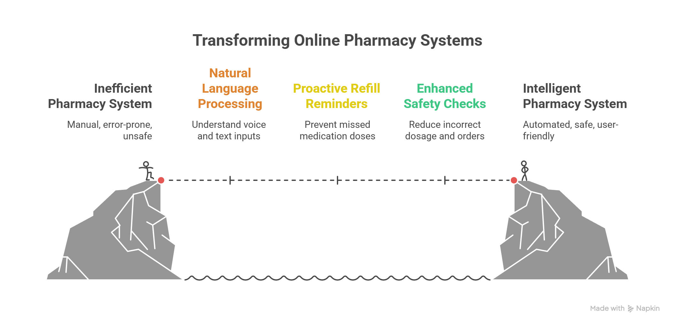
Problem Statement
Current Challenges in Online Pharmacy System:
1 => Manual search and selection of medicines.
2 => No understanding of natural language or voice inputs.
3 => High risk of incorrect dosage or unsafe orders.
4 => Lack of proactive refill reminders.
5 => Limited safety checks and explainability.
Problem: Existing systems are reactive, rule-based, and user-dependent, leading to inefficiency and safety risks.

Slide 3
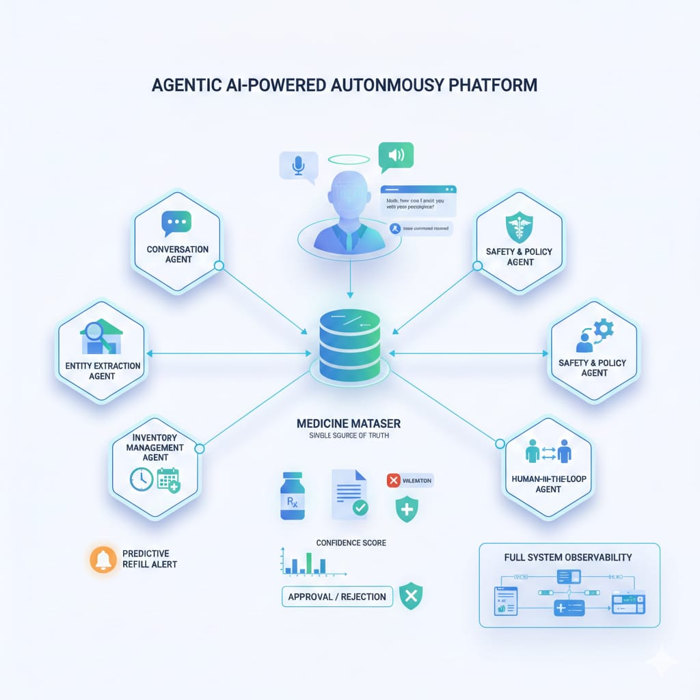
Proposed Solution
Agentic AI-Powered Pharmacy Platform:
Key Features:
Conversational AI (text & voice)
Automatic extraction of:
1: Medicine name
2:Dosage
3:Quantity
4:Autonomous order approval or rejection
5:Minimal human intervention
6:Acts as a virtual pharmacist
Goal:
Enable safe, intelligent,
and fully autonomous medicine ordering

Slide 4
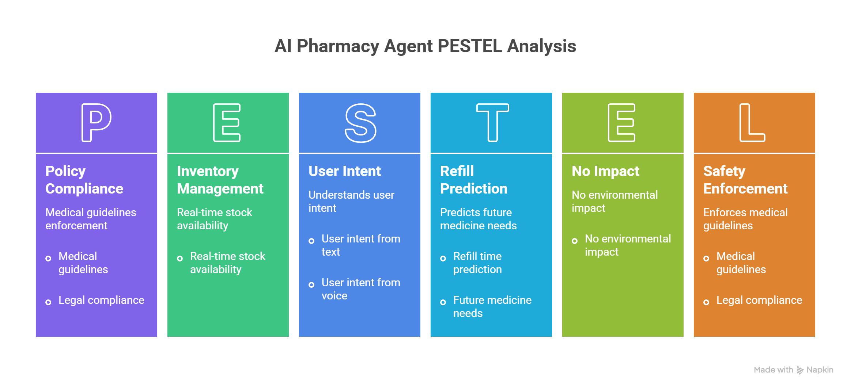
System Architecture
Core AI Agents:
AI Agent | Role / Function
Conversation Agent | Understands user intent from text or voice input
Entity Extraction Agent | Extracts medicine name, dosage, and quantity
Safety & Policy Agent | Enforces medical guidelines and legal compliance
Inventory Agent | Checks real-time stock availability
Refill Prediction Agent | Predicts future medicine needs and refill time
Human-in-the-Loop Agent | Handles high-risk or uncertain cases requiring human review

Slide 5
Intelligence, Safety & Observability
Safety & Reliability Measures:
1: Confidence scoring for entity extraction.
2: Explainable decision generation for every order.
3: Automatic rejection of unsafe or invalid orders.
4: Abuse and suspicious behavior detection.
Observability:
1: Logs every agent action.
2: Tracks decisions, confidence, and policy checks.
3: Enables transparency and debugging.

Slide 6
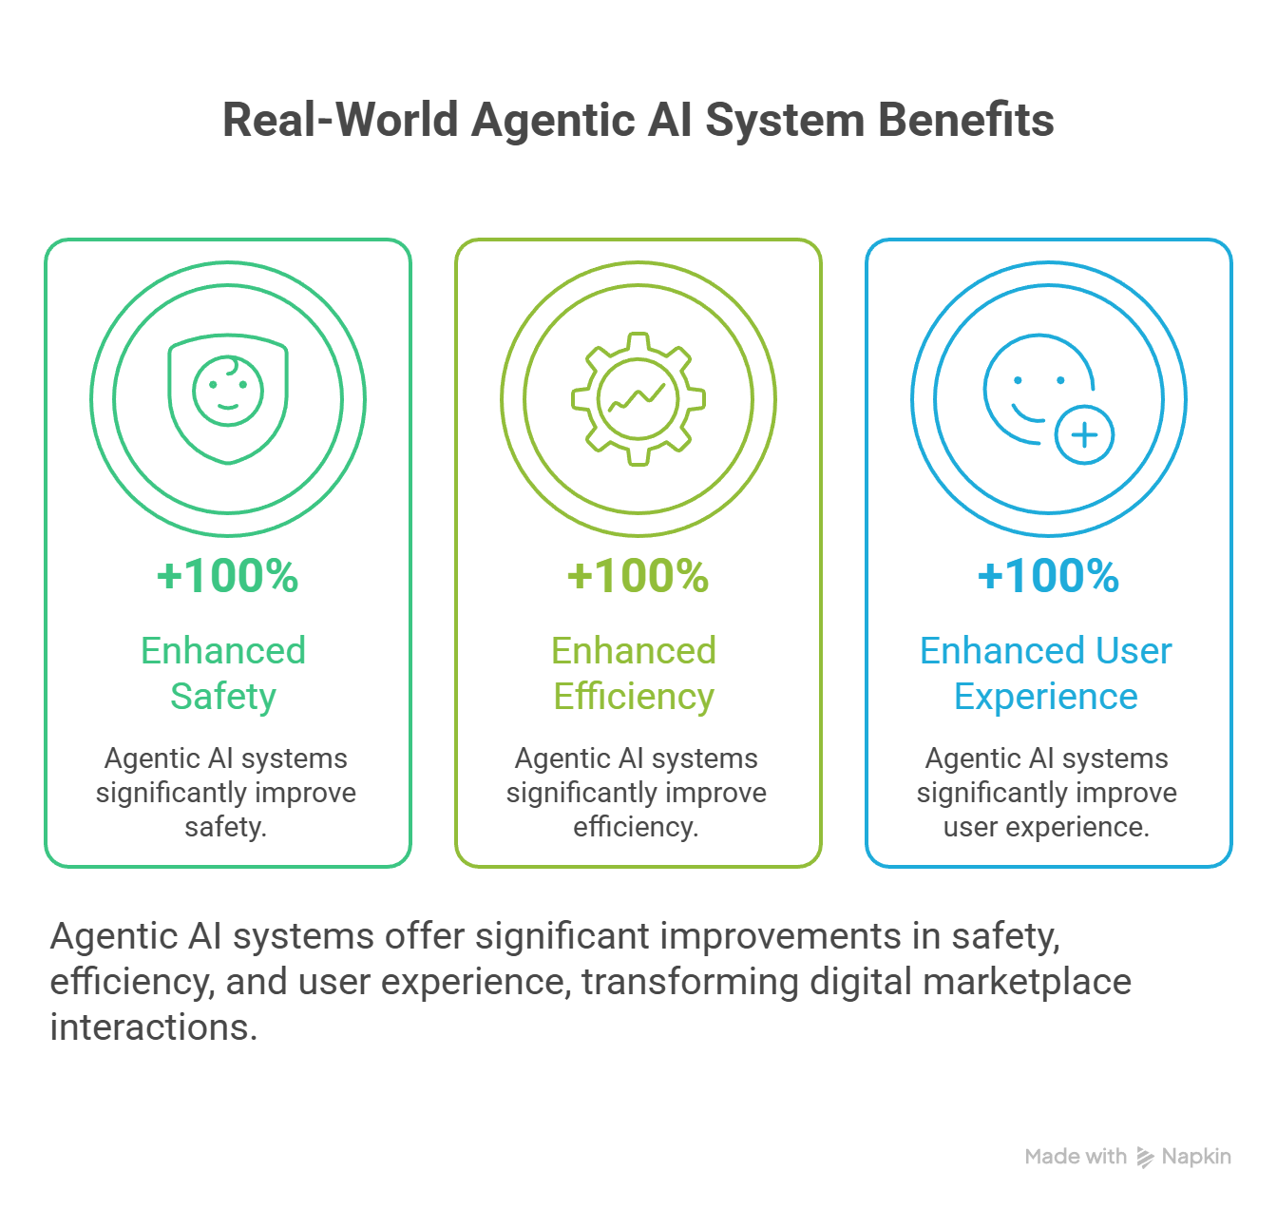
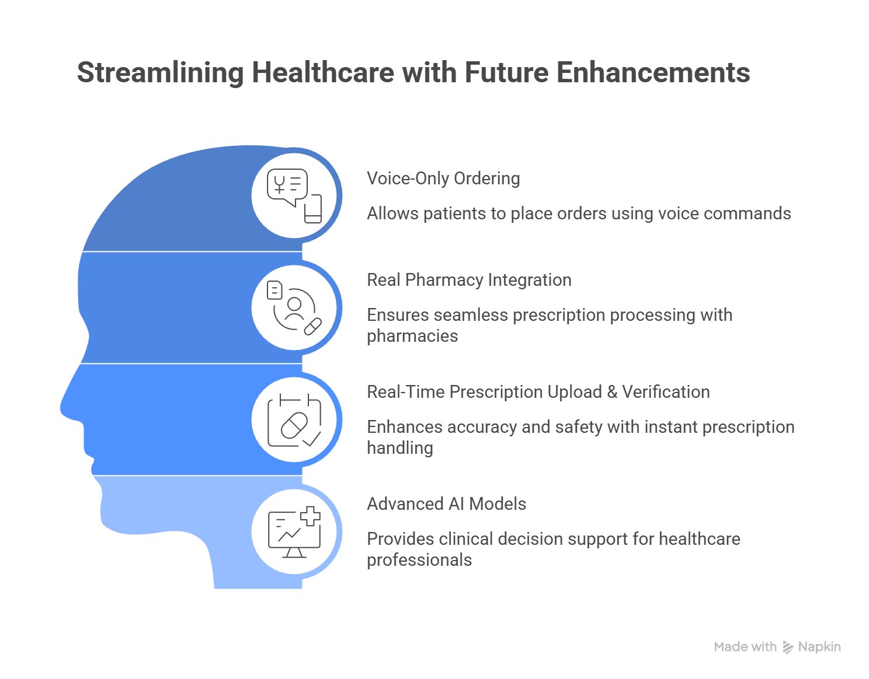
Conclusion & Future Scope

